Slide 1
AES Key Expansion

Slide 2
AES uses key expansion process to create each round key
If number of rounds are Nr it creats Nr+1, 128 bit round key from one single 128bit cipher key
First key is for pre round transformantion
Remaining are used in each round

Slide 3
Key expansion routine creats round keys word by word where a word is an array of four bytes.
The routine creats 4* (Nr+1) words that are called
W0,W1,W2, ………W4(Nr+1)
AES 128 version have 44 words
192 have 52 words
256 have 60 words

Slide 4
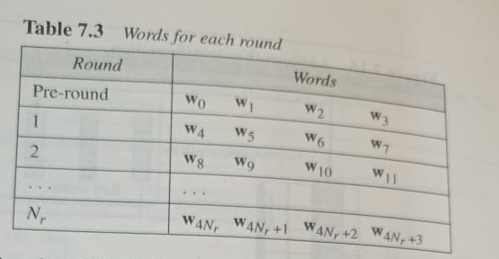

Slide 5
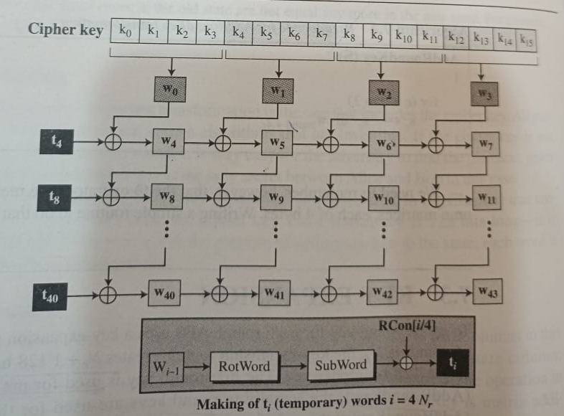

Slide 6
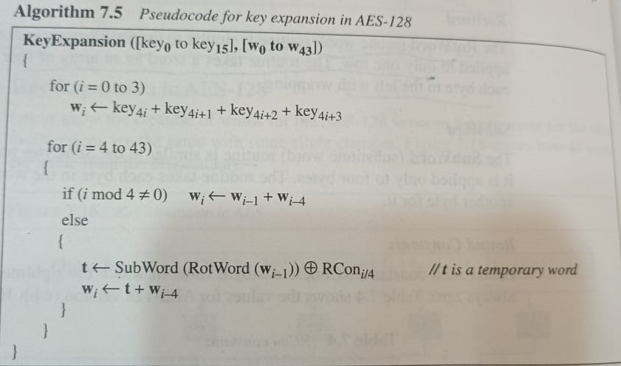

Slide 7
where t is a temporary word result of applying two routines, subword, rotwor on wi-1 and xoring result with a round constant, Rcon
t= Subword(rotword(wi-1)xor rconi/4
Rotword: similar to shift row, applied to only one row.
Subword: similar to subbyte transformation applied to 4 bytes.
Round constant: 4 byte value in which rightmost three bytes will always 0.

